Slide 1
NEWS SUMMARIZATION AND CLUSTERING.
Group Members:-
Akash Guje - C0835284
Noah David - C0846073
Jebin George - C0850509

Slide 2
INTRODUCTION:
We are creating a news summarizing API with this problem in mind, where you may enter the topic, you're interested in learning about and receive the condensed version of lengthy and tiresome news items from Google news

Slide 3
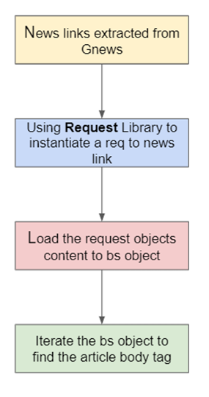
GNEWS
Googlenews package within python is an API used to scrape and retrieve news from google news platform. Using this package, we can extract news based on topic for last N number of days.

Slide 4
WEB SCRAPING
We also used request library present in python to instantiate a request to the given news article. By this we were able to collect the HTML skeleton of the article webpage. Now, this request object’s content attribute is passed to the beautiful soup object to extract the news
This entire functionality is encapsulated in the extract_news(link) function. In this function we also collect the HTML script tag with the attributes type='application/ld+json',text=True

Slide 5
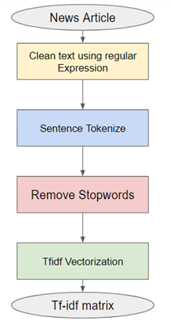
TEXT PREPROCESSING
We performed below operations for text preprocessing:
Cleaning using RE.
HTML Tags <tag>.
Markdown Url’s.
Text or Code in brackets.
Standalone sequences for specials, punctuations and newline characters
Tokenizing
Stopwords removal
Tfidf Vectorization

Slide 6
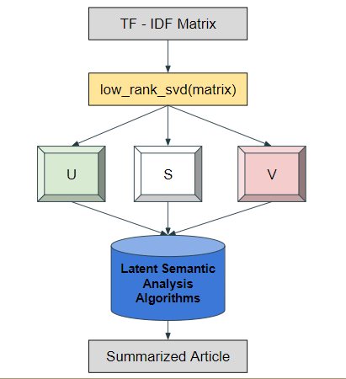
TEXT SUMMARIZATION
We have employed latent semantic analysis to do text summarization. The fundamental tenet of latent semantic analysis (LSA) is that there exists a latent structure in each document among terms that are contextually related and ought to be corelated in the same single space
Singular Value Decomposition is a linear algebra technique that is the foundation of our approach. Factorizing a real or complex matrix is what SVD does

Slide 7
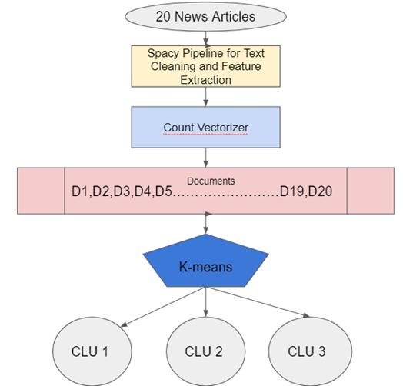
CLUSTERING TO GENERATE HEADLINES

Slide 8
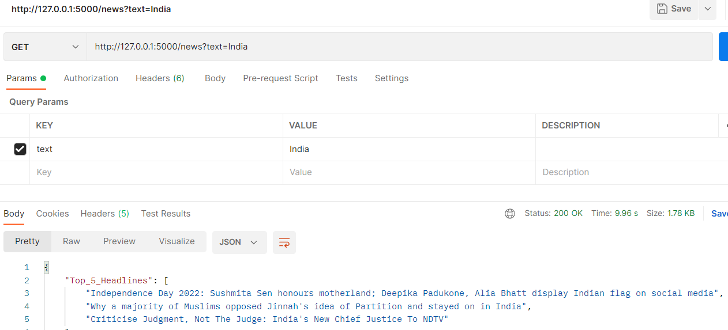
FLASK API
LASK API ENDPOINT is /news prefix by out local host ip address.
We give two outputs with this API
Top Headlines
Summarized news
Title
Source
Article

Slide 9
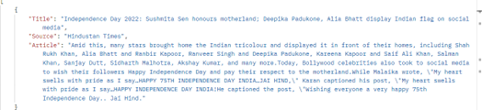
FLASK API

Slide 10
FLASK API

Slide 11
REFERENCES
[1] Danang Tri Massandy, M. L. (2014). Guided summarization for Indonesian news articles. IEEE.
[2] Ekaterina Zolotareva, T. M. (2020). Abstractive Text Summarization using Transfer Learning. Budapest: CEUR Workshop.
[3] Hujia Yu, C. Y. (2016). News Article Summarization with Attention-based. stanford, 1-7.
[4] Josef Steinberger, K. J. (2004). Using Latent Semantic Analysis in Text Summarization and Summary Evaluation. researchgate.
[5] Roy, A. (2020). Understanding Automatic Text Summarization-1: Extractive Methods. towardsdatascience.
[6] Sarkar, D. (2019). Text Analytics with Python. Bangalore: Apress.
[7] Woojin, G. (2022). How to read Google News RAPIDLY using a short python script. medium.
[8] Yue Dong, Y. S. (2018). BanditSum: Extractive Summarization as a Contextual Bandit. Brussels: Aclanthology.

